Slide 1
Object-Oriented Software Engineering
Practical Software Development using UML and Java
Developing Requirements

Slide 2
In this Lecture you will learn about the following
Domain analysis
Understanding the customer’s problem and setting the scope for the project.
What exactly is a requirement, as well as the various types of requirements.
Requirements documents and what should be put in them.
How to go about gathering requirements.
How to model users’ tasks using use case diagrams and detailed descriptions of use cases.
How to review a set of requirements.
Chapter 4: Developing requirements

Slide 3
4.1 Domain Analysis
The process by which a software engineer learns about the domain to better understand the problem:
  The word domain is the general field of business or technology in which the clients will use the software.
  People who work in a domain and who have a deep knowledge of it (or part of it) are called domain experts.
  To perform domain analysis, you gather information from whatever sources of information are available: these include
      the domain experts
      any books about the domain
      any existing software and its documentation.
Chapter 4: Developing requirements

Slide 4
4.1 Domain Analysis
Benefits of performing domain analysis:
  Faster development
      able to communicate with the stakeholders more effectively.
      able to establish requirements more rapidly.
      domain analysis will help you to focus on the most important issues.
  Better system
      Knowing the subtleties of the domain will help ensure that the solutions you adopt will more effectively solve the customer’s problem.
  Anticipation of extension
      Armed with domain knowledge, you will obtain insights into emerging trends and you will notice opportunities for future
      development. This will allow you to build a more adaptable system.
Chapter 4: Developing requirements

Slide 5
Domain Analysis document
It is useful to write a summary of the information found during domain analysis.
      It can help you gain a better grasp of the knowledge; the resulting document can help educate other software engineers who join the team later.
Domain analysis document should be divided into following sections
  A. Introduction
  B. Glossary
  C. General knowledge about the domain
  D. Customers and users
  E. The environment
  F. Tasks and procedures currently performed
  G. Competing software
  H. Similarities to other domains
Chapter 4: Developing requirements

Slide 6
Domain Analysis document
  Introduction
      Name the domain, and give the motivation for performing the analysis.
  Glossary
      Describe the meanings of all terms used in the domain that are either not part of everyday language or else have special meanings
      The section is best placed at the start of the domain analysis document so that you can subsequently use the defined terms.
  General knowledge about the domain
      Summarize important facts or rules
  Customers and users
      Describe who will or might buy the software, and in what industrial sectors they operate.
Chapter 4: Developing requirements

Slide 7
Domain Analysis document
The environment
      Describe the equipment and systems used.
Tasks and procedures currently performed
      Make a list of what the various people do as they go about their work.
      Tasks listed in this section may be candidates for automation.
Competing software
      Describe what software is available to assist the users and customers.
        software that is already in use, and software on the market.
Similarities to other domains
      determine what distinguishes this domain and the customer’s organization from others, as well as what they have in common.
Chapter 4: Developing requirements

Slide 8
Exercise 1:
Outline in one paragraph the information you would need to gather in order to perform domain analysis for an airline reservation system.
Chapter 4: Developing requirements

Slide 9
Solution:
How airline flights are scheduled.
How fares are set and structured.
How ticketing and booking works in the customer’s airline and other airlines.
How the various people in the airline reservation business, including travel agents and airline employees, do their jobs.
What existing reservation systems are capable of doing and how they work.
What laws, regulations and other rules govern the industry.
Study the functionality of competing reservation systems, particularly the many web-based systems currently available.
Chapter 4: Developing requirements

Slide 10
Exercise
Describe as many sources of information as you can think of, that should be consulted in order to perform a domain analysis for each of the following systems.
(a) The police information system.
(b) The household alarm system.
Chapter 4: Developing requirements

Slide 11
Solution
Police Information System
      Police officers and staff (interviews, brainstorming and observing work)
      Police training and procedures manuals
      Documentation of existing software and equipment used by the police (including competing products)
      Books about police methods
      Similar information about related activities such as court procedures, etc.
Chapter 4: Developing requirements

Slide 12
Solution
Household alarm system
      Personnel at alarm companies, emergency-response dispatching organizations, alarm equipment manufacturers
      Procedures manuals at alarm companies and emergency-dispatching organizations
      Documentation and web sites about alarm hardware and existing alarm systems
      Experience using actual existing alarm systems
      Documentation about the network and other hardware that would be connected to the alarm system
      Potential end users and customers of the alarm system
Chapter 4: Developing requirements

Slide 13
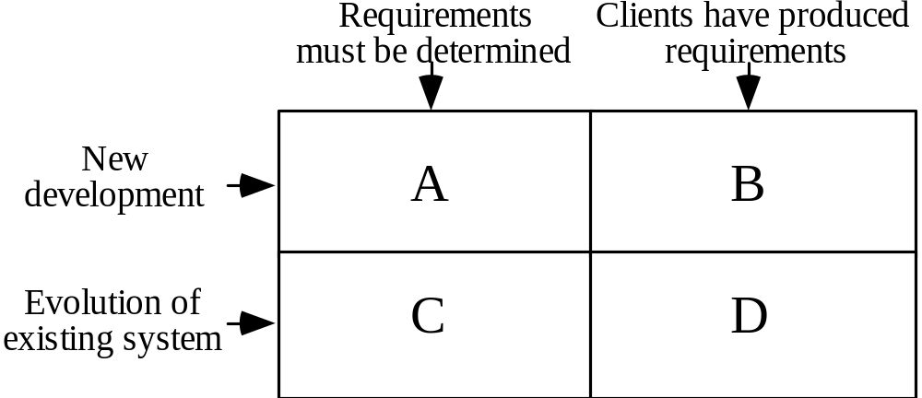
4.2 The Starting Point for Software Projects
When a development team starts work on a software project, their starting point
can vary considerably. We can distinguish different types of project, based on whether or not software exists at the outset, and whether or not requirements exist at the outset.
green field project
Chapter 4: Developing requirements

Slide 14
4.3 Defining the Problem and the Scope
After domain analysis – determine the requirements
      The first step in this process is to work out an initial definition of the problem to be solved.
A problem can be expressed as:
      A difficulty the users or customers are facing.
      Or as an opportunity that will result in some benefit such as improved productivity or sales.
The solution to the problem normally will entail developing software.
A good problem statement is short and succinct – one or two sentences is best.
Chapter 4: Developing requirements

Slide 15
Example:
System: Student Registration System
You might express the problem as follows:
‘The system will allow students to register for courses, and change their registration, as simply and rapidly as possible. It will help students achieve their personal goals of obtaining their degree in the shortest reasonable time while taking courses that they find most interesting and fulfilling(proposing courses based on an analysis of the student’s academic and personal-interest profiles..).
If the problem is broad, -system will have a broad scope, and hence be more complex.
‘the system will automate all the functions of the registrar’s office’
That leaves open the possibility of including such features as fee payment, printing class lists and allocating rooms to courses.
Chapter 4: Developing requirements

Slide 16
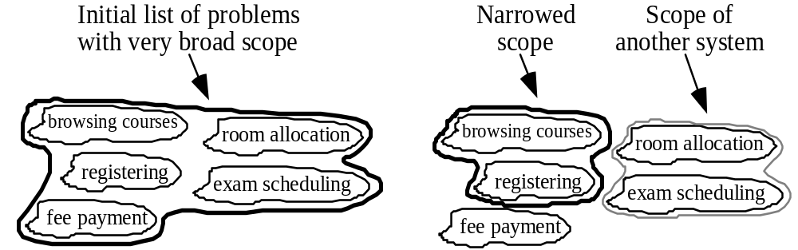
Defining the Scope
Narrow the scope by defining a more precise problem
Sometimes, an inappropriate choice of problem statement can result in a
scope that is too narrow or completely wrong.
      what will be the user’s ultimate high-level goal when they use the system, and the customer’s high-level goal for having it developed.
Example: A university registration system
Chapter 4: Developing requirements

Slide 17
4.4 What is a Requirement ?
It is a statement describing either
  an aspect of what the proposed system must do, or
  2) a constraint on the system’s development.
      In either case it must contribute in some way towards adequately solving the customer’s problem.
      the set of requirements as a whole represents a negotiated agreement among the stakeholders.
A collection of requirements is a requirements document.
Chapter 4: Developing requirements

Slide 18
4.5 Types of Requirements
Functional requirements
  Describe what the system should do
The functional requirements can be further categorized as follows:
      What inputs the system should accept, and under what conditions. This includes data and commands both from the users and from other systems.
      What outputs the system should produce, and under what conditions. Outputs can be to the screen or printed. They can also be transmitted to other systems.
      What data the system should store that other systems might use.
      What computations the system should perform.
      The timing and synchronization - in hard real-time systems that do such things as control hardware devices.
Chapter 4: Developing requirements

Slide 19
Example:
An individual requirement often covers more than one of the above categories.
For example, the requirements for a word processor might say,
‘when the user selects “word count”, the system displays a dialog box listing the number of characters, words, sentences, lines, paragraphs, pages, and words per sentence in the current document.’
This requirement clearly describes input (selecting ‘word count’), output (what is displayed) and computation (counting all the necessary information, and computing the average words per sentence).
Chapter 4: Developing requirements

Slide 20
4.5 Types of Requirements
Quality requirements
  Constraints on the design to meet specified levels of quality.
Platform requirements
  Constraints on the environment and technology of the system
Process requirements
  Constraints on the project plan and development methods.
Chapter 4: Developing requirements

Slide 21
Quality Requirements
All must be verifiable
Examples: Constraints on
  Response time
      systems that process a lot of data or use a network extensively, you should require that the system gives results or feedback to the user in a certain minimum time.
      For example, you might write that a result must be calculated in less than three seconds, or that feedback about the progress of a search must appear within one second.
  Resource usage
      specify the maximum amount of these resources that the system will consume.
Chapter 4: Developing requirements

Slide 22
Quality Requirements
  Reliability
      Reliability is measured as the average amount of time between failures or the probability of a failure in a given period.
      For example, you might specify that a continuously running server must not suffer more than one failure in a six-month period.
  Availability
      Availability measures the amount of time that a server is running and available to respond to users.
  Recovery from failure
      Requirements in this category constrain the allowed impact of a failure.
      For example, the requirements for a word processor might state:
      ‘the system will allow users to continue their work after a failure with the loss of no more than 20 words of typing or 20 formatting commands.’
Chapter 4: Developing requirements

Slide 23
Quality Requirements
  Allowances for maintainability and enhancement
      In order to ensure that the system can be adapted in the future, you should describe changes that are anticipated for subsequent releases.
  Allowances for reusability
      a certain percentage of the system, e.g. 40%, measured in terms of lines of code, must be designed generically so that it can be reused.
Chapter 4: Developing requirements

Slide 24
Platform requirements
Computing platform
      what hardware and operating system the software must be able to work on.
Technology to be used.
      give the designers as much flexibility as possible in choosing how to implement the system.
      sometimes constraints must be imposed. Common examples are to specify the programming language or database system.
Chapter 4: Developing requirements

Slide 25
Process requirements
Development process (methodology) to be used.
      In order to ensure quality, some requirements documents specify that certain processes be followed; for example, particular approaches to testing.
Cost and delivery date.
      These are important constraints. However, they are usually not placed in the requirements document, but are found in the contract for the system or are left to a separate project plan document.
Chapter 4: Developing requirements

Slide 26
Exercise
Classify the following aspects of an airline reservation system into F for
functional, Q for quality, PL for platform, PR for process, and X for ‘should not be a requirement’. Also indicate the subcategory of requirement. For something that should not be a requirement, explain why not.
How information about flights, passengers and bookings are entered.
What information appears on tickets and reports.
How fares are calculated.
What information must be stored in the database that travel agents and others access.
Chapter 4: Developing requirements

Slide 27
Exercise
5. The system should be designed such that it can be extended to handle a frequent-flier plan.
6. The system must be available at all times. Only 2 minutes’ downtime a week is to be permitted.
7. The system must run on any Linux system..
8. A merge-sort algorithm must be used to sort the flights by departure time.
Chapter 4: Developing requirements

Slide 28
Solution
■ How information about flights, passengers and bookings are entered. F: Input.
■ What information appears on tickets and reports. F: Output.
■ How fares are calculated. F: Computation.
■ What information must be stored in the database that travel agents and others access. F: Data storage.
■ The system should be designed such that it can be extended to handle a frequent-flier plan. Q: Allowance for enhancement.
■ The system must be available at all times. Only 2 minutes’ downtime a week is to be permitted. Q: Availability.
■ The system must run on any Linux system. PL: Computing platform.
■ A merge-sort algorithm must be used to sort the flights by departure time. X: This is a design issue.
Chapter 4: Developing requirements

Slide 29
Exercise
The following requirement is stated in an unverifiable way. For each, indicate the kind of requirement it is, and rewrite it so that it is verifiable (make up some suitable details).
The automatic teller machine should be fast.
Chapter 4: Developing requirements

Slide 30
Solution
Constraint on response time (Although it is ambiguous what this is actually constraining)
The automated teller machine should at all times respond to user input with feedback in 0.5s.
All debit, deposit and balance inquiries to the customer’s own bank must be completed in 5s.
All transactions made by interacting with another bank must be completed in 10s.
Chapter 4: Developing requirements

Slide 31
4.6 Use-Cases: describing how the user will use the system
A use case is a typical sequence of actions that a user performs in order to complete a given task
  The objective of use case analysis is to model the system from the point of view of
    … how users interact with this system
    … when trying to achieve their objectives.
    It is one of the key activities in requirements analysis.
  A use case model consists of
    a set of use cases
    an optional description or diagram indicating how they are related.
Chapter 4: Developing requirements

Slide 32
Use cases
A use case should
  Cover the full sequence of steps from the beginning of a task until the end.
  Describe the user’s interaction with the system ...
    Not the computations the system performs.
  Only include actions in which the actor interacts with the computer.
    Not actions a user does manually
Chapter 4: Developing requirements

Slide 33
How to describe a single use case
A. Name: Give a short, descriptive name to the use case.
B. Actors: List the actors who can perform this use case.
C. Goals: Explain what the actor or actors are trying to achieve.
D. Preconditions: State of the system before the use case.
E. Summary: Give a short informal description.
F. Related use cases. List use cases that may be generalizations, extensions or inclusions of this one.
G. Steps: Describe each step using a 2-column format.
H. Postconditions: State of the system in following completion.
A and G are the most important
Chapter 4: Developing requirements

Slide 34
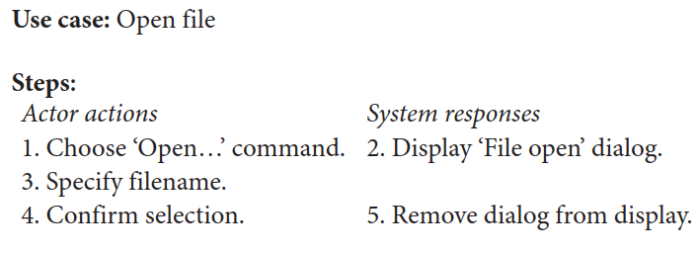
G. Steps: Describe each step using a 2-column format.
Chapter 4: Developing requirements

Slide 35
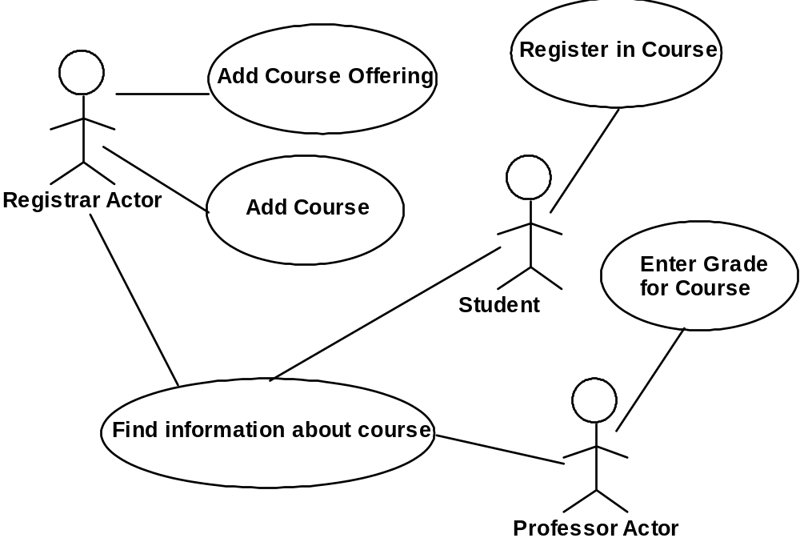
Use case diagrams
Chapter 4: Developing requirements

Slide 36
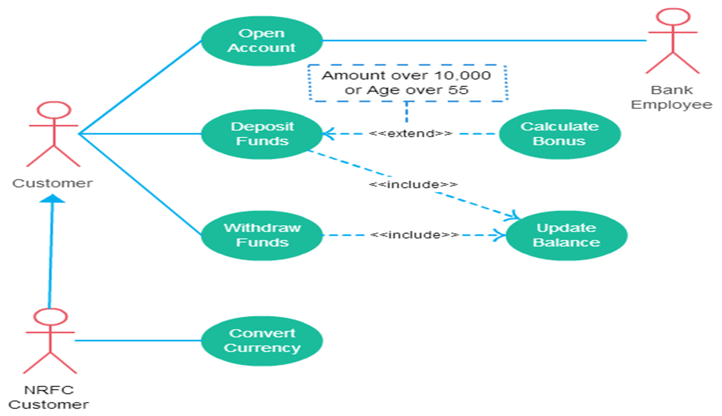
Example of generalization, extension and inclusion
Chapter 4: Developing requirements

Slide 37
The modeling processes: Choosing use cases on which to focus
  Often one use case (or a very small number) can be identified as central to the system
    The entire system can be built around this particular use case
    For example, in an airline reservation system, the central use case will be ‘Reserve a seat on a flight’. Once identified, the system can be built around this particular use case.
  There are other reasons for focusing on particular use cases:
    Some use cases will represent a high risk because for some reason their implementation is problematic.
    Some use cases will have high political or commercial value.
Chapter 4: Developing requirements

Slide 38
The benefits of basing software development on use cases
They can
  Help to define the scope of the system
  Be used to plan the development process
  Be used to both develop and validate the requirements
  Form the basis for the definition of test cases
  Be used to structure user manuals
Chapter 4: Developing requirements

Slide 39
4.7 Some Techniques for Gathering and Analysing Requirements
Observation
  Read documents and discuss requirements with users.
  observing the users at work
    ask the user to explain everything he or she is doing.
    Observation, and analyzing the resulting information, can consume a large amount of time.
    Therefore it is best done only for the development of large systems with which potential users will be performing complex tasks.
Chapter 4: Developing requirements

Slide 40
4.7 Some Techniques for Gathering and Analysing Requirements
Interviewing
  well-conducted series of interviews can elicit much more information
    Ask about specific details
    Ask about the stakeholder’s vision for the future
    Ask if they have alternative ideas
    Ask for other sources of information
    Ask them to draw diagrams
Chapter 4: Developing requirements

Slide 41
Gathering and Analysing Requirements...
Brainstorming
Brainstorming is an effective way to gather information from a group of people.
Call a meeting with representation from all stakeholders.
  Appoint an experienced moderator
  Arrange the attendees around a table
  Decide on a ‘trigger question’ A trigger question is one for which the participants can provide simple one-line answers that are more than just numbers or yes/no responses.
  Ask each participant to write an answer and pass the paper to its neighbour
Joint Application Development (JAD) is a technique based on intensive brainstorming sessions
Chapter 4: Developing requirements

Slide 42
Gathering and Analysing Requirements...
Prototyping
  The simplest kind: paper prototype.
    a set of pictures of the system that are shown to users in sequence to explain what would happen
  The most common: a mock-up of the system’s UI
    Does not normally perform any computations, access any databases or interact with any other systems
    May prototype a particular aspect of the system
Chapter 4: Developing requirements

Slide 43
Gathering and Analysing Requirements...
Use case analysis
  Determine the classes of users that will use the facilities of this system (actors)
  Determine the tasks that each actor will need to do with the system
Chapter 4: Developing requirements

Slide 44
4.8 Types of Requirements Document
Two extremes:
    An informal outline of the requirements using a few paragraphs or simple diagrams
      requirements definition
    A long list of specifications that contain thousands of pages of intricate detail
      requirements specification
Requirements
xxxx
xxxxxxx
xxx
xxxxxxxxxxx
xxxxx
xxxxxxxxxxxxx
xxxxxxx
xxx
xxxxxxxxxxxxxxx
  Requirements documents for large systems are normally arranged in a hierarchy
  There is a top-level document describing the overall system, its subsystems and how the subsystems interact.
subsystem 1
subsystem 2
Requirements
Requirements
xxxx
Definition
xxxxxxx
xxxx
xxx
xxxxxxx
Requirements
xxxxxxxxxxx
xxx
xxxxx
xxxxxxxxxxx
Specification
xxxxxxxxxxxxx
xxxxx
xxxxxxx
xxxx
xxx
xxxxxxxxxxxxx
xxxxxxxxxxxxxxx
xxxxxxx
xxxxxxx
xxx
xxx
xxxxxxxxxxx
xxxxxxxxxxxxxxx
xxxxx
xxxxxxxxxxxxx
sub-subsystems
xxxxxxx
xxx
Requirements
Requirements
Requirements
Requirements
xxxxxxxxxxxxxxx
Definition
Definition
Definition
Definition
xxxx
xxxx
xxxx
sub-subsystems
xxxx
xxxxxxx
xxxxxxx
xxxxxxx
Requirements
xxx
xxx
xxxxxxx
xxx
Requirements
Requirements
xxxxxxxxxxx
xxx
Requirements
xxxxxxxxxxx
xxxxxxxxxxx
xxxxx
Specification
xxxxxxxxxxx
Specification
Specification
Specification
xxxxx
xxxx
xxxxx
xxxxx
xxxxxxxxxxxxx
xxxxxxxxxxxxx
xxxx
xxxx
xxxxxxx
xxxxxxxxxxxxx
xxxxxxxxxxxxx
xxxxxxx
Requirements
xxxxxxx
xxxx
xxxxxxx
xxxxxxx
xxxxxxx
xxxxxxx
xxx
xxx
Requirements
xxxxxxx
xxx
xxx
xxx
xxx
xxxxxxxxxxx
Definition
xxx
xxx
xxxxxxxxxxxxxxx
xxxxxxxxxxxxxxx
Definition
xxxxxxxxxxx
xxxxxxxxxxx
xxxxx
xxxxxxxxxxxxxxx
xxxxxxxxxxxxxxx
xxxx
xxxxxxxxxxx
xxxxx
xxxxx
xxxxxxxxxxxxx
xxxx
xxxxxxx
Requirements
xxxxx
xxxxxxxxxxxxx
xxxxxxxxxxxxx
xxxxxxx
xxxxxxx
Requirements
xxxxxxxxxxxxx
xxxxxxx
xxx
xxx
Definition
Requirements
xxxxxxx
xxx
Definition
xxxxxxx
xxx
xxx
xxxxxxxxxxxxxxx
xxxxxxxxxxx
xxxxxxxxxxx
xxxx
xxxxx
Specification
xxx
xxxxxxxxxxxxxxx
xxxxxxxxxxxxxxx
xxxxx
xxxx
xxxxxxx
xxxxxxxxxxxxx
xxxxxxxxxxxxxxx
xxxxxxxxxxxxx
xxxxxxx
Requirements
xxxx
xxx
xxx
Requirements
xxxxxxx
Requirements
xxxxxxx
xxxxxxx
xxxxxxxxxxx
xxxxxxxxxxx
xxx
xxx
xxx
xxxxx
Specification
Specification
Specification
xxxxx
xxxxxxxxxxxxxxx
xxxxxxxxxxxxxxx
xxxx
xxxxxxxxxxx
xxxxxxxxxxxxx
xxxxxxxxxxxxx
xxxx
xxxxx
xxxxxxx
xxxx
xxxxxxx
xxxxxxx
xxxxxxx
xxxxxxx
xxx
xxxxxxxxxxxxx
xxx
xxx
xxxxxxx
xxx
xxx
xxxxxxxxxxx
xxxxxxxxxxxxxxx
xxxxxxxxxxxxxxx
xxxxxxxxxxx
xxxxxxxxxxx
xxxxx
xxx
xxxxx
xxxxx
xxxxxxxxxxxxx
xxxxxxxxxxxxxxx
xxxxxxxxxxxxx
xxxxxxxxxxxxx
xxxxxxx
xxxxxxx
xxxxxxx
xxx
xxx
xxx
xxxxxxxxxxxxxxx
xxxxxxxxxxxxxxx
xxxxxxxxxxxxxxx
Chapter 4: Developing requirements

Slide 45
Level of detail required in a requirements document
  How much detail should be provided depends on:
    The size of the system
      A large system will need more detailed requirements for several reasons.
        More to say
        Divided into subsystems and parallel teams may work on it.
    The need to interface to other systems
    The readership
    The stage in requirements gathering
        Once all the stakeholders agree with a short, informal statement of requirements, successive levels of detail can be added.
        Prototype then detailed requirements.
    The level of experience with the domain and the technology
    The cost that would be incurred if the requirements were faulty
Chapter 4: Developing requirements

Slide 46
4.9 Reviewing Requirements
  Each individual requirement should
    Have benefits that outweigh the costs of development
        Cost benefit analysis
    Be important for the solution of the current problem
    Be expressed using a clear and consistent notation
      Whichever format is used, consistent style should be applied throughout the requirements document.
    Be unambiguous
    Lead to a system of sufficient quality
    Be realistic with available resources
    Be verifiable
    Be uniquely identifiable
    Does not over-constrain the design of the system
        requirement should avoid indicating how it will be implemented, in order to give the designer as much freedom as possible to make decisions.
Chapter 4: Developing requirements

Slide 47
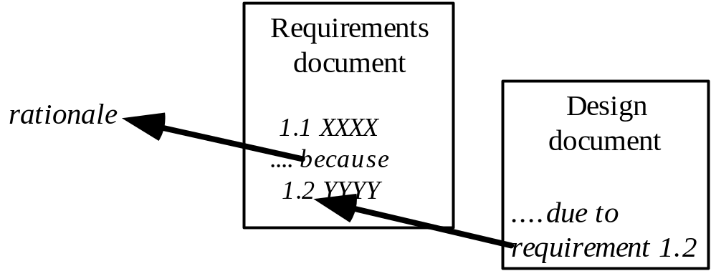
Requirements documents...
    The document should be:
    sufficiently complete
    well organized
    clear
    agreed to by all the stakeholders
    Traceability:
Chapter 4: Developing requirements

Slide 48
Requirements document...
  Problem
    Provide a succinct description of the problem the system is solving.
  Background information
    Give information that will help readers understand the requirements.
  Environment and system models
    Provide the context in which the system runs and a global overview of the system or subsystem. Diagrams are very useful here.
  D. Functional Requirements
  Non-functional requirements
    Describe any constraints that must be imposed on the design of the system.
Chapter 4: Developing requirements

Slide 49
4.10 Managing Changing Requirements
Requirements change because:
  Business process changes
  Technology changes
  The problem becomes better understood
Requirements analysis never stops
  Continue to interact with the clients and users – asking them about their problems and their ideas – show prototype
  The benefits of changes must outweigh the
    Certain small changes (e.g. look and feel of the UI) are usually quick and easy to make at relatively little cost.
    Larger-scale changes have to be carefully assessed
      Forcing unexpected changes into a partially built system will probably result in a poor design and late delivery – reject more complex and less important requirement changes
    keeping track of the different versions of requirements documents.
Chapter 4: Developing requirements

Slide 50
4.13 Difficulties and Risks in Domain and Requirements Analysis
  Lack of understanding of the domain or the real problem
    Do domain analysis and prototyping
  Requirements change rapidly
    Perform incremental development, build flexibility into the design, do regular reviews
  Attempting to do too much
    Document the problem boundaries at an early stage, carefully estimate the time
  It may be hard to reconcile conflicting sets of requirements
    Brainstorming, JAD sessions, competing prototypes
  It is hard to state requirements precisely
    Break requirements down into simple sentences and review them carefully, look for potential ambiguity, make early prototypes
Chapter 4: Developing requirements

